Slide 1
Data Mining DS-303
Lecture 1
Muhammad Arham
Lecturer
The University of Faisalabad

Slide 2




www.tuf.edu.pk
unioffaisalabad
Credit Hours: 3(2-1)
Theory: Cr. Hr. 02
Practical: Cr. Hr. 01

Slide 3
Marking Scheme
www.tuf.edu.pk
unioffaisalabad
Mid Exam= 25 Marks
Final Exam= 40 Marks
Practical = 50 Marks
Sessional = 35 Marks
Assignment 1 (5)
Assignment 2 (5)
Quiz 1 (05)
Quiz 2 (05)
Presentations (05)
Projects (10)
Total Marks: 100 + 50

Slide 4
Lab Work
www.tuf.edu.pk
unioffaisalabad
Quiz 1 = 05 Marks
Quiz 2 = 05 Marks
Lab Manual = 10 Marks
Project/Assignment = 15 Marks
Viva = 5 Marks
Practical = 10 Marks
Total Marks: 50

Slide 5
Rules to Remember
www.tuf.edu.pk
unioffaisalabad
Assignments and quizzes submitted late will result in a deduction of marks.
Do not rely fully on the instructors.
Keep your mobile Silent and keep it inside your bag.
Students should remain attentive during class and avoid use of Mobile phone, Laptops or any gadgets
Raise your hand before speaking or leaving your seat.
Convey your issue to your instructor through your CR.
Partially or fully copied assignments will be marked as ZERO.
There will be no extension in the deadlines.
All students must come to class on time (Attendance will be taken in first 5 to 10 mins)
Respect faculty and staff through actions and speech
After every lab, chairs will be arranged properly, and cleanliness will be maintained to ensure a good environment.

Slide 6
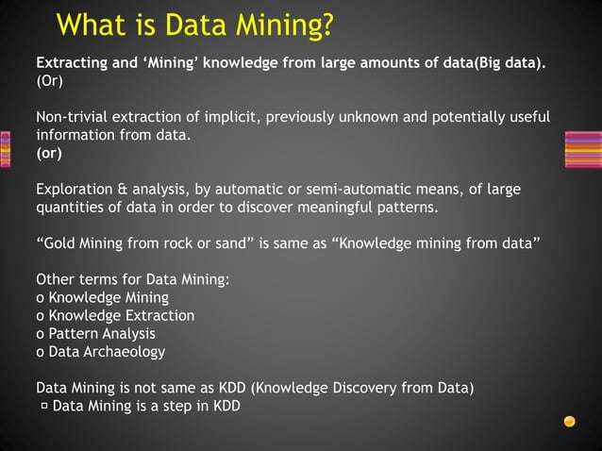

Slide 7


Slide 8


Slide 9
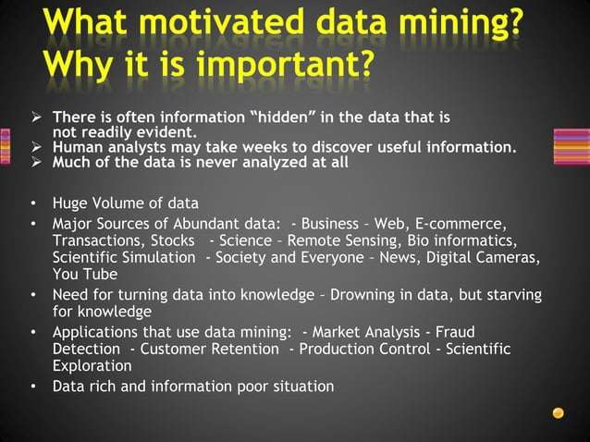

Slide 10
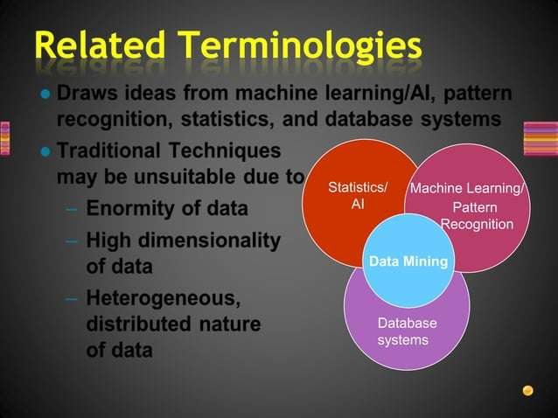

Slide 11
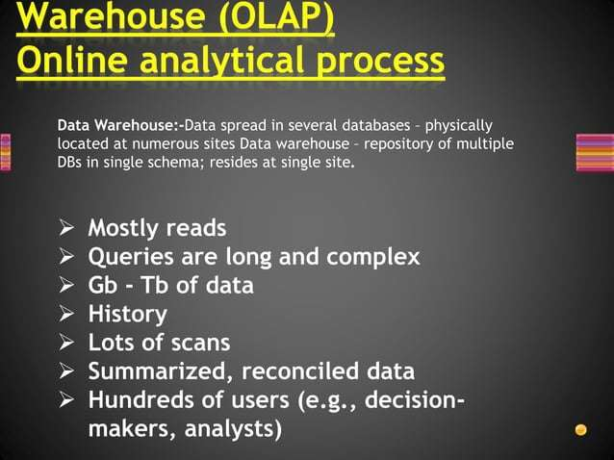

Slide 12


Slide 13


Slide 14


Slide 15
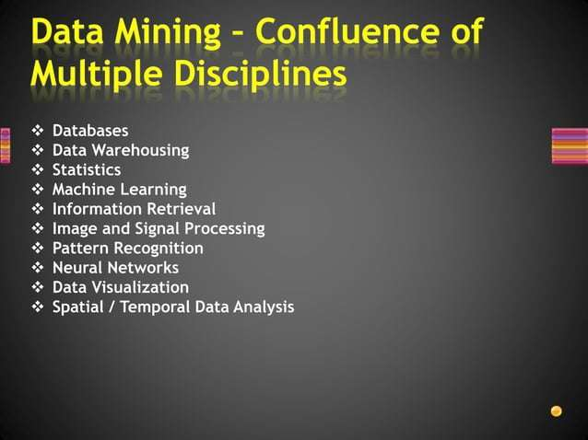

Slide 16
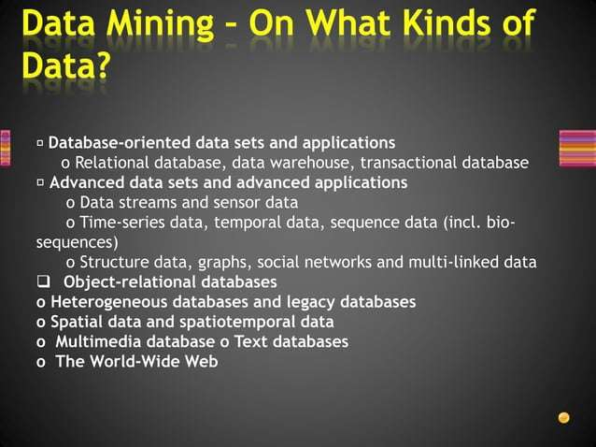

Slide 17
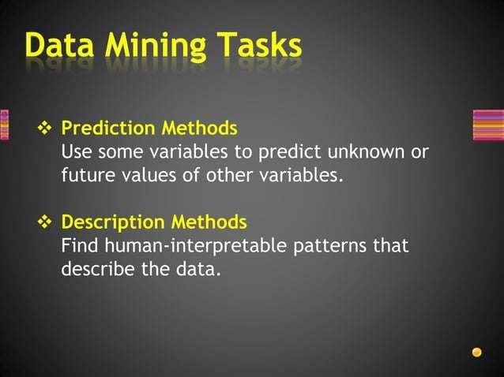

Slide 18
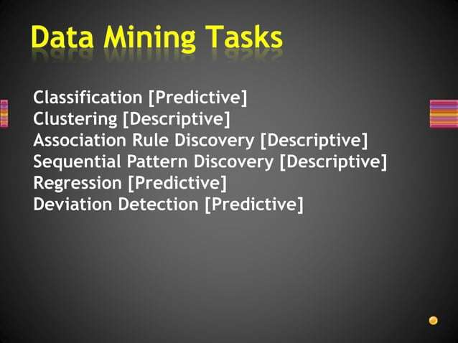

Slide 19


Slide 20


Slide 21


Slide 22
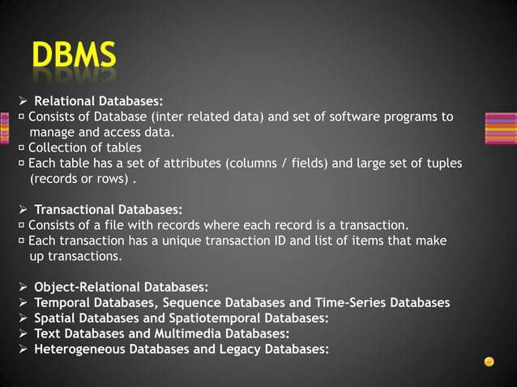

Slide 23
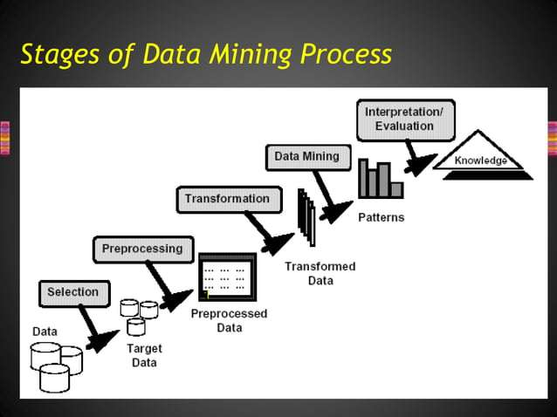

Slide 24
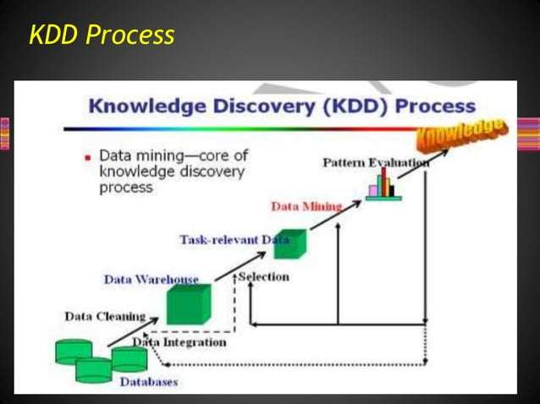

Slide 25
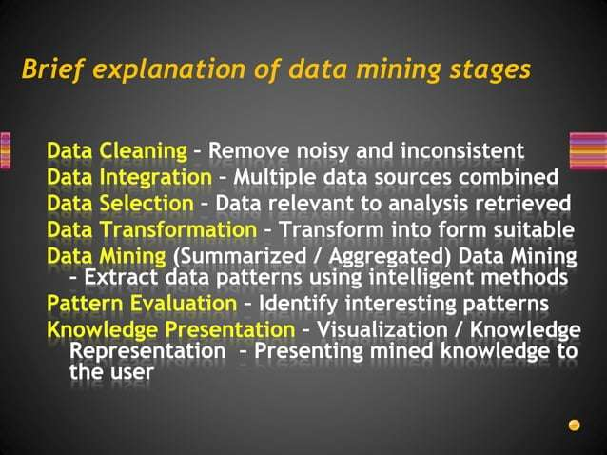

Slide 26
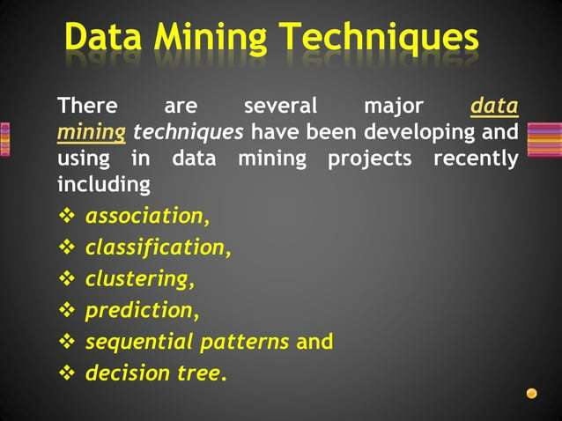

Slide 27


Slide 28
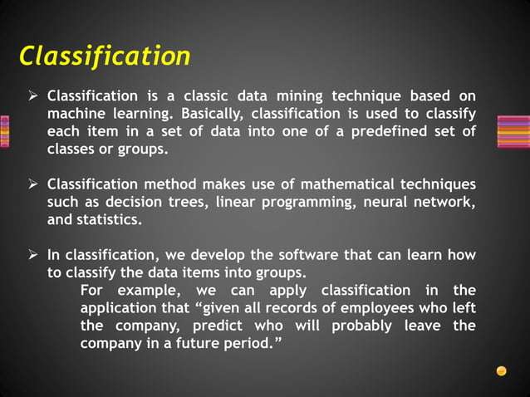

Slide 29
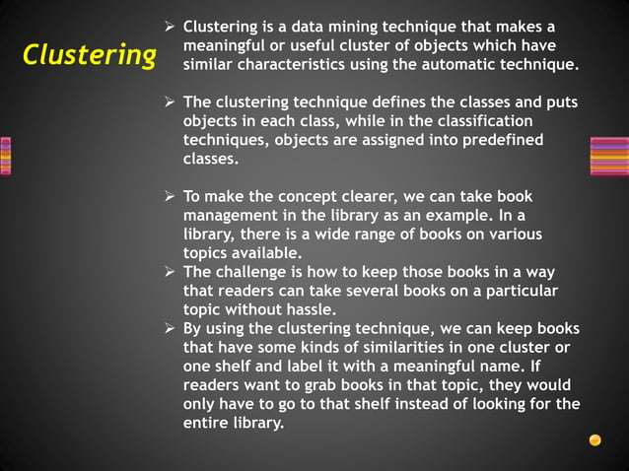

Slide 30
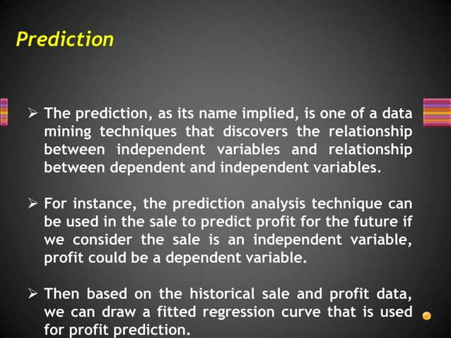

Slide 31
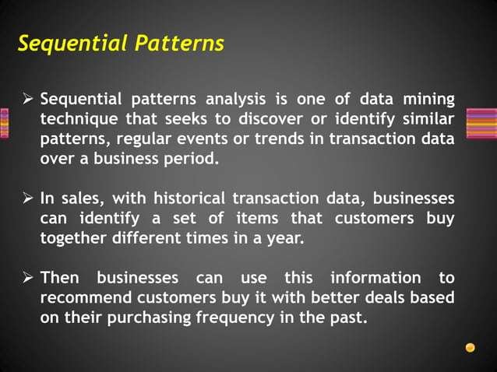

Slide 32
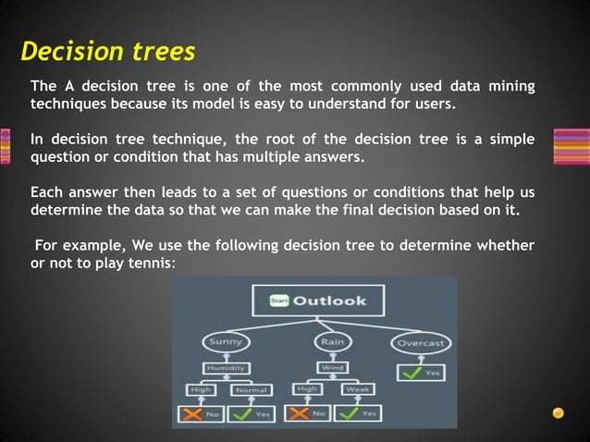

Slide 33
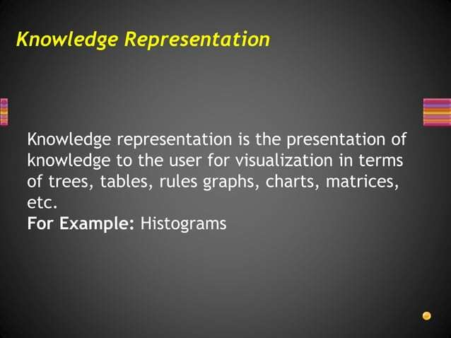

Slide 34
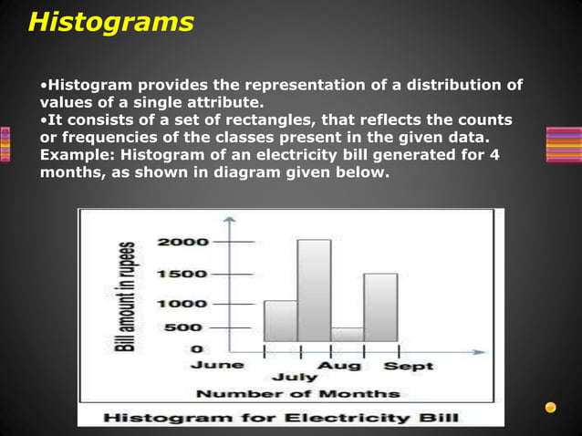

Slide 35
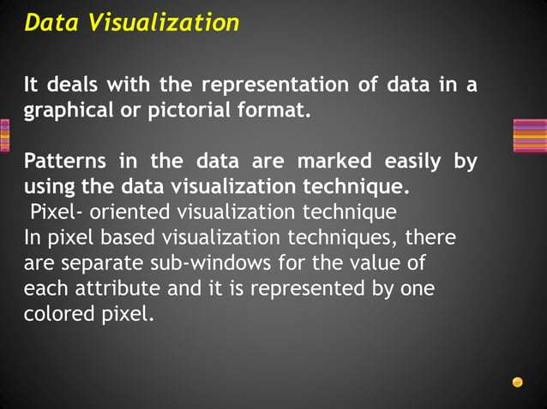

Slide 36
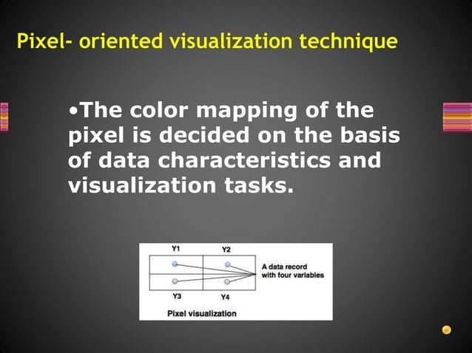

Slide 37
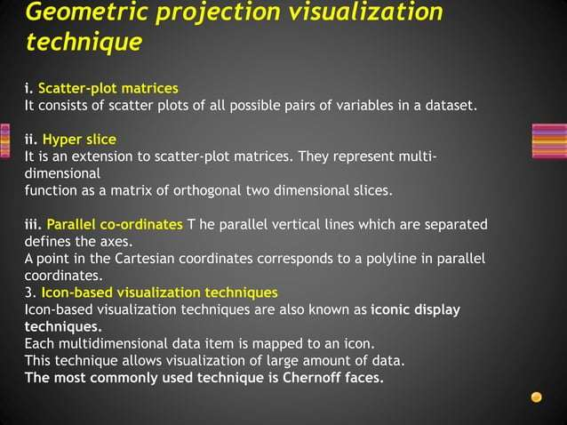

Slide 38
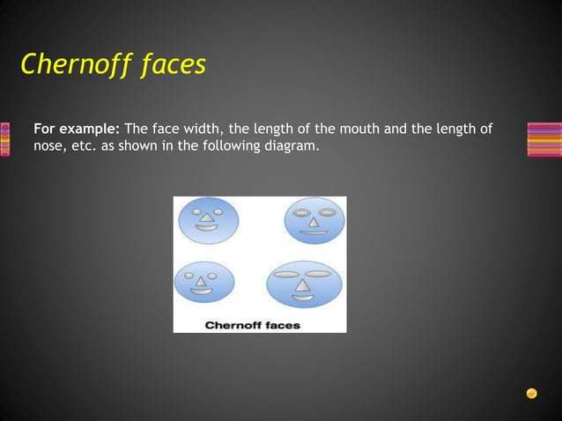

Slide 39
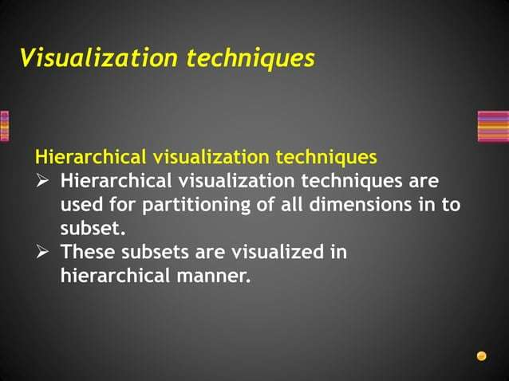

Slide 40
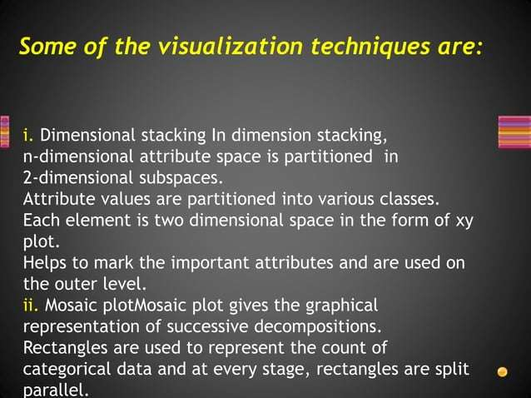

Slide 41
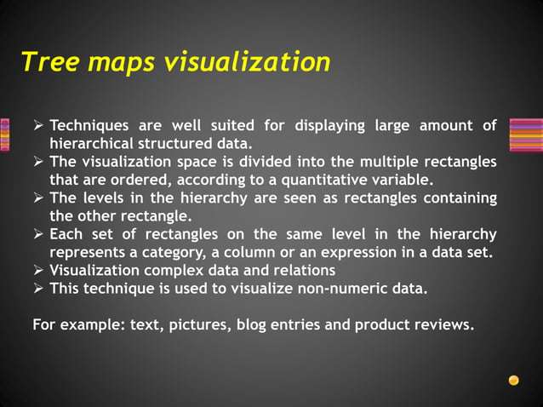

Slide 42
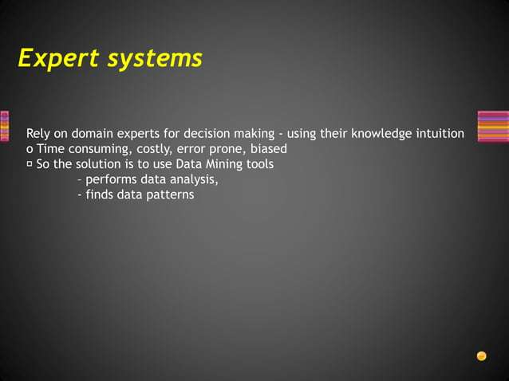

Slide 43
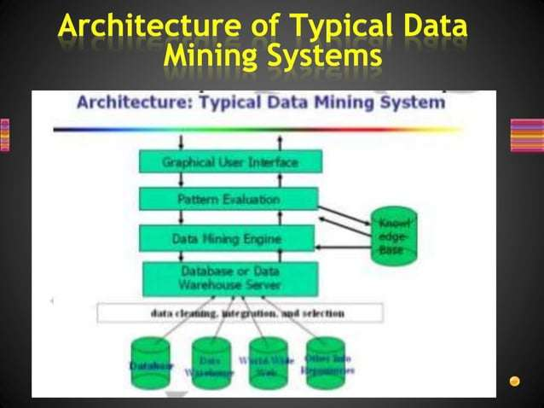

Slide 44
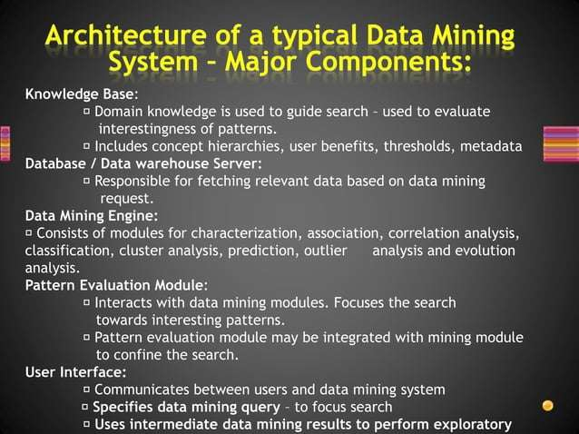

Slide 45


Slide 46
